Slide 1
Henkel Case Study
Peter Quinn
06/10/2017

Slide 2
Did you know…
… that Henkel is the world's number one adhesives producer?
… that Henkel sells detergents for around 25 billion wash loads per year?
… that every second, more than 20 hair colorants from Henkel are sold worldwide?

Slide 3
Who we are
Henkel at a glance 2016
More than 50,000 employees worldwide
42% of our sales generated in emerging markets
Around €18.7 bn sales, +3.1% organic sales growth
More than 2,000 social projects supported
€3.2 bn adjusted¹ operating profit (EBIT)
More than 140 years
of success
¹ Adjusted for one-time charges/gains and restructuring charges.

Slide 4
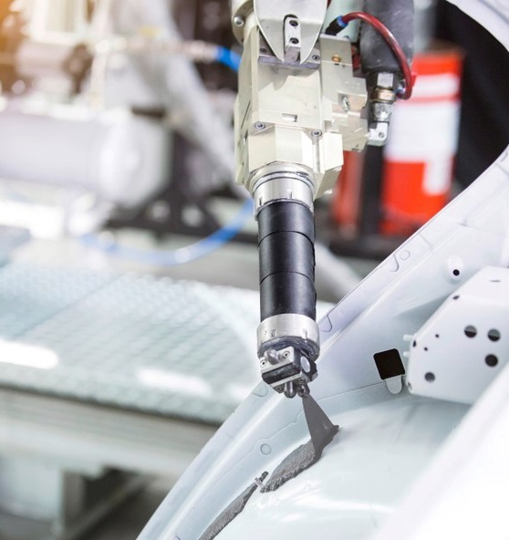
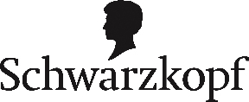
Who we are
Global leading positions in consumer and industrial businesses
Adhesive Technologies
Beauty Care
Laundry & Home Care

Slide 5
Who we are
Adhesive Technologies
€8,961 m sales
30% innovation rate²
+2.8% organic sales growth
>80% of our sales generated with our top 10 brands
€1,629 m
adjusted¹ operating profit (EBIT)
¹ Adjusted for one-time charges/gains and restructuring charges.
² Percentage share of sales generated with new products launched onto the market within the last five years.

Slide 6
Henkel Ireland Operations & Research Ltd. Henkel Ireland at a glance
~ 400 employees in Ireland
120
employees in R&D
250
employees in Ops
~ €300m Originates from Dublin
Dublin is host to Global Support Groups:
- PSRA - Global Quality - Finance
- 3PM - Packaging Design - HR - Sales
Notes:
6

Slide 7
History & Background
2008 – 2014 Dublin Operations had severe challenges:
Sustained period of poor service
Dublin Operations seen as expensive
Poor Union - Management Relations
Under-investment in both factories in Dublin leading to safety issues
Notes:
7

Slide 8
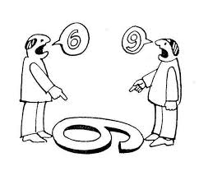
History and Background Contd:
We Were in a Bad Place
Union and Management relationships in shreds
A breakdown in respect, trust and communication
Not a strategic site anymore
Low morale…….It wasn’t nice being here
We Needed To Be In a Better Place
Notes:
8

Slide 9
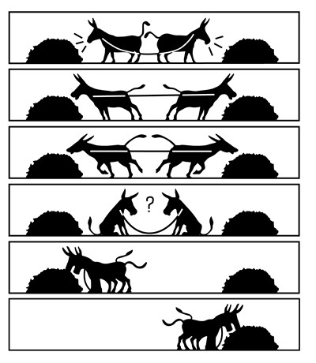
The Critical ‘Leap of Faith’
Understanding on all sides that something had to change
New Leadership approach
Willingness to engage from unions
New three year agreement with three unions
Investigated IDEAS as a mechanism
Dedication by all to find a ‘New Way of Working’
Notes:
9

Slide 10
JUMP AHEAD was born:
J Joint A All
U Union H Henkel
M Management E Engaged
P Partnership A And
D Delivering
Notes:
10

Slide 11
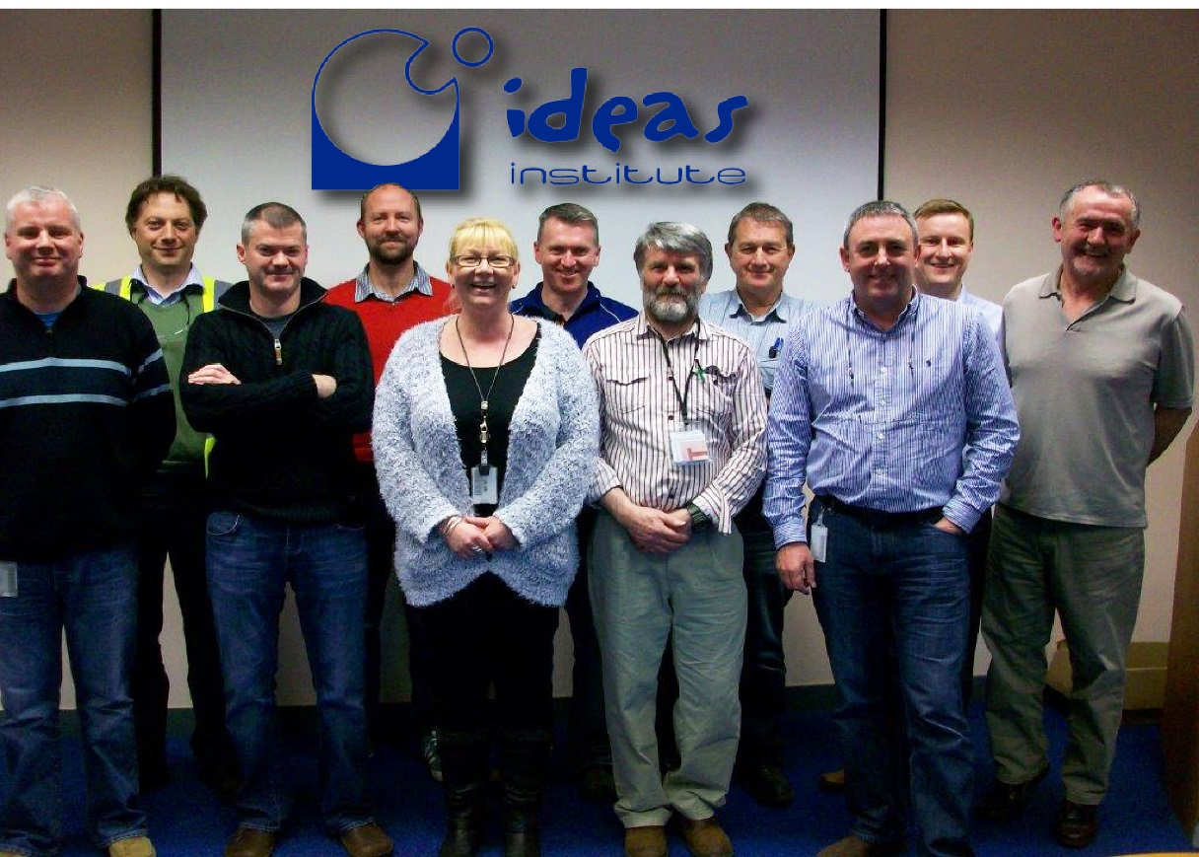
JUMP AHEAD Steering Team
Notes:
11

Slide 12
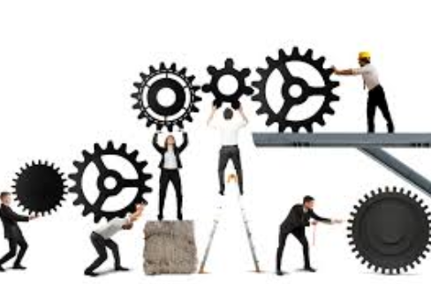
How it works:
Natural teams are selected by the steering team and trained by IDEAS institute
Problems are identified by the teams
The teams liaise with the steering team to prioritise the problems
The teams resolve the problems using tools from the training
Notes:
12

Slide 13
Natural teams:
Teams have five or six members and are a mixture of people from various grades and positions
While the team work on problems in their own area they can look for help from people outside that area
Areas | Example of Natural Teams
Anaerobics | Operator, Supervisor, Craft, SHE, QC
Ballyfermot | Craft, Operators, Supervisor, QC
B&P AWIP | Craft, Operators, Supervisor, W/H Operator, QC
B&P ACON | W/H Operator, Set-Up Operator, Engineer, Chargehand, Area Manager
B&P AINCA | Craft, Operators, Customer Service, Planner
Logistics | Operators, Chargehand, Manager, Planner
Notes:
13

Slide 14
Training schedule & Time Commitment
Team Training is 3 x 2 days
FETAC Level 5 Qualification (optional)
2015 - 2017 – Trained 80 people - Training of new teams will continue over the next number of years
Teams meet once a week
Steering team meets once a week
Sitewide communications once per quarter
Notes:
14

Slide 15
How it has affected our people:
Everyone benefits from improvements within their work place
Everyone has the opportunity to volunteer and take part in a team
People get exposure to parts of the business that they may not normally have been involved with
Morale is improved by being part of a more connected team - Connected with each other and with our employer
People have become part of the new success story
Notes:
15

Slide 16
What are the Risks/Pitfalls
Key influencers can move or be promoted
The programme has to constantly refresh, innovate & re-energise
There are less ‘Glass Half Empty’ people but they will still exist
Funding, scale & flexibility of the programme
Keeping IR topics separate is critical but difficult
Egos and orthodoxies can be hard to manage
Important to choose the right projects at the start
Notes:
16

Slide 17
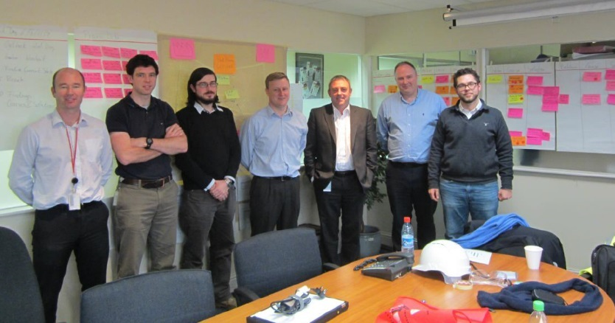
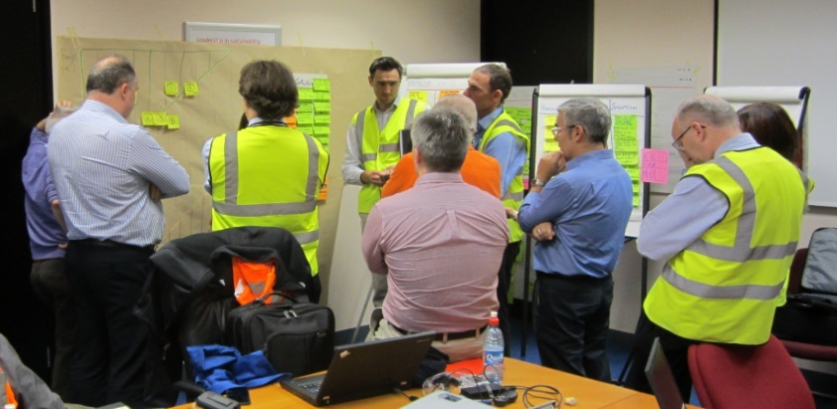
So how did we do in the last three years?
Service – 80% avg to 98% avg
Quality – Complaints reduced by 37%
Cost – Productivity gains 5% P.A. - Scrap down 25%
Zero Lost Time Safety Incidents for 3 years
Absenteeism reduced by 45%
Notes:
17

Slide 18
But Most Importantly we are: -
Striving to build trust, innovation, engagement and fulfilment in the workplace
Working together to create a future
Committed to making open engagement work
Taking the joint responsibility to be open, transparent and respectful in our dealings
And want all to share in the success of this programme
Notes:
18

Slide 19
Thank you!

