Slide 1
Gerry McCormack Deputy General Secretary – Private Sector
Launch of the Stratis FTL Ireland
Workplace Innovation Network
Friday, 6th October 2017

Slide 2
What benefits for Trade Unions & Workers with WPI? What is SIPTU/IDEAS Institute Model for WPI ? What’s next ? And where do we go from here?
“Workplace Innovation in Ireland”

Slide 3
What benefits for Trade Unions & Workers with WPI?
Supports employee involvement/engagement.
Provides efficiencies, increased production, productivity improvements.
Helps to secure manufacturing employment in Ireland.
Helps to manage change more effectively.
Provides a greater understanding of the needs of all stake holders in any organization.
Site of choice for future FDI in companies.
It’s the right thing to do!

Slide 4
What is SIPTU/IDEAS Institute Model for WPI ?
The IDEAS Institute is a ‘not for profit’ company owned by SIPTU.
Provides the technical and logistical support for the introduction of WPI for SIPTU.
SIPTU has a policy to encourage and implement WPI wherever possible.
Expertise provided by Tony Murphy, Workplace Innovation Engineer.

Slide 5
“Manufacturing is evolving and it will be different in the future – … High-value manufacturing activities in Ireland will be knowledge-intensive, capital-intensive and skills-intensive. Successful firms will engage in developing a participative culture, where management and staff work collectively to ensure the success and longer term sustainability of the firm to the benefit of all.”
(SOURCE: The Report of the High Level Group on Manufacturing – Towards 2016 – March 2008)
Notes:
“Manufacturing is evolving and it will be different in the future – … High-value manufacturing activities in Ireland will be knowledge-intensive, capital-intensive and skills-intensive. Successful firms will engage in developing a participative culture, where management and staff work collectively to ensure the success and longer term sustainability of the firm to the benefit of all.”
(SOURCE: The Report of the High Level Group on Manufacturing – Towards 2016 – March 2008)

Slide 6
SIPTU /IDEAS Joint Policy Initiative -- 2011
NEW POLICY put forward…....
We are committed to retaining / sustaining manufacturing employment levels in Ireland. This Policy was formally announced at Strategic Manufacturing Conference on 24th November 2011 in Gresham Hotel, Dublin with EU Commissioner Ms Máire Geoghegan-Quinn in attendance.
We are committed to collaborate with all stakeholders (including Irish state agencies such as Forfas, IDA, Enterprise Ireland and employers) to achieve this.
Our strategy, the introduction of Workplace Innovation, and our unique approach to its implementation, is critical to achieve our stated policy aims….i.e. saving jobs
Notes:
SIPTU Manufacturing Division/ IDEAS policy Initiative
Policy
to retain / sustain manufacturing & employment levels in Ireland.
Collaborate with all stakeholders (state agencies / employers to achieve this goal).
Innovation in Manufacturing Conference (Nov 2011)
Commissioner Máire Geoghegan-Quinn
Minister Séan Sherlock
General President Jack O’Connor
(Factories of the Future / Horizon 2020)
Presently engaging with all the Stakeholders
DJEI / LRC /Forfás/IBEC

Slide 7
A Realisation………at last!!!!
“…. The mental capacity of our people to solve problems and improve performance, is the key to sustained competitiveness. We need to maximise the potential of our people to deliver improved productivity using proven tools and techniques”…….
Source: “Applied Benchmarking for Competitiveness – A Guide for SME Owner/Managers” Richard Keegan and Eddie O’Kelly 2004 Oak Tree Press, Cork

Slide 8
Workplace Innovation.
SIPTU/Ideas model is the key to our unique approach to successful implementation of Workplace Innovation.
This presentation will outline how IDEAS/SIPTU go about unlocking this largely untapped creative potential within the entire workforce……

Slide 9
How do we enable this potential ?
We have developed a unique joint union-management approach to implementing Workplace Innovation……which,
Acknowledges existing skills/experience,
Encourages engagement, builds trust, and
Through genuine employee involvement we can then unlock this highly creative, and largely untapped, potential within the entire workforce.

Slide 10
The Challenge…………………………
How do we create “a participative culture, where management and staff work collectively to ensure the success and longer term sustainability of the firm to the benefit of all!?”
….. First, a brief review of how “change” is frequently implemented…
Notes:
So……
How do we create “a participative culture, where management and staff work collectively to ensure the success and longer term sustainability of the firm to the benefit of all!?”

Slide 11
When Major Change is to be Implemented, 3 Options may be considered:-
Rarely Works
Insertion
of Change
↓
Most
Commonly
Used
Preferred
Option
- Requires
Real
Leadership
2. Power
3. Hearts & Minds
1. Rational Discussion
Notes:
Let me show you some of the work we have been doing in moving towards this type of futuristic structure.
When major change is to be implemented, there are 3 options available:
Rational discussion – rarely works
Power – Insertion of change, pushed downwards ↓into the organisation – most commonly used
Hearts & Minds – requires real leadership, persuasion and education
Source: “Why Your Corporate Culture Change Isn't Working and What to Do about It”.. Michael Ward Gower Publishing UK 1995)

Slide 12
Our approach draws on each option – and combines all three…………..!!
Provides
the Context
Both Directions
- ↑Pull from
the Top
- ↑Push from
the Bottom
Given freely
through agreeing
a vision and
providing
leadership to
achieve it
1. Rational Discussion
2. Power
3. Hearts & Minds
Notes:
Our model draws on EACH of the above:
Rational Discussion provides the context
Power – both directions – pull from the top and push from the bottom
Hearts & Minds – given freely through agreeing a vision and providing leadership to achieve it

Slide 13
OUR MODEL – Establish a Joint approach involving all players..
1
2
3
Formation of
Joint Union
Management
Steering Group
(JUMSG)
- Consists
of Influencers
& Leaders
Terms of Reference
Completion of
Team Training together:
(FETAC 5N1367 – Level 5)
Terms of Reference
Ground Rules
“Where we are now?”
Vision for the future
Communication Plan
Preliminary “Roadmap”
to achieve vision,
includes schedule of training
for entire workforce
Ability to work together
“Win/Win” Philosophy
Ground Rules
“
Continuous
Monitoring
& Support by
JUMSG
- Determining
timely corrective
actions as required
Notes:
Our Model
1.Formation of Joint Union Management Steering Group (JUMSG)
- Consists of influencers & leaders
2.Completion of Team Training together:
(FETAC G20034 – Level 5)
Joint Development of:
-Terms of Reference
-Ground Rules
-Where we are now?
-Vision for the future (Where we all want to be?) (Glimpse of the Factory of the Future)
-Communication Plan to raise awareness of everybody in the factory
-Preliminary “Roadmap” to achieve vision, includes schedule of training for entire workforce
-Ability to work together in a new meaningful & constructive fashion
-”Win/Win” Philosophy
3.Continuous Monitoring & Support by JUMSG
-Determining timely corrective actions as required

Slide 14
Current list of companies engaged ……
KIRCHHOFF Ireland, Letterkenny, County Donegal German
LEO PHARMA Crumlin, Dublin Danish
KERRY FOODS Charleville, Cork Irish
BECTON DICKINSON Drogheda, Louth USA
(both Irish sites) Pottery Road, Dublin
SAICA Ashbourne, Meath Spanish
THEO BENNING GmBh Wexford German
WAVIN Balbriggan Dutch
THK Tallaght Japanese
Bausch & Lomb (Valeant) Waterford Canadian
Wyeth (NESTLE) Askeaton, Limerick Swiss
Henkel ----- 2 sites in Tallaght German
Dublin city Ballyfermot
Tara Mine –Boliden Navan, Meath Swedish
Fleetwood Virginia, County Cavan Irish
Notes:
This model is already in place and delivering tangible results in several factories across the country.
Selection of Companies involved are:
- KIRCHHOFF Ireland Letterkenny
- LEO PHARMA, Crumlin Dublin 12
- KERRY FOODS Charleville Co Cork
- BECTON DICKINSON, Drogheda
- SAICA Ashbourne, Co. Meath
- THEO BENNING, Wexford
- WAVIN, Balbriggan, Co. Dublin

Slide 15
The story thus far…. ….
We believe we have developed a proven, robust working model that has already sustained manufacturing jobs in Ireland.
This model encourages “win/win/win” outcomes --- i.e., “wins” for the individual, the organisation and society.
We believe this model is universal ---- and can be adapted to work anywhere ---and also in applications other than traditional manufacturing.
We will continue to strive to sustain/retain manufacturing jobs in Ireland by actively encouraging workplace innovation and employee involvement at all levels in organisations.
Notes:
We at the IDEAS Institute believe we have developed a proven working model and would like to expand our activities to include:
- Working with more companies to retain/ sustain manufacturing in Ireland by encouraging innovation and creativity at all levels within factories.
- Continuously improving our own existing skills, developing and using additional new and innovative tools/ techniques/ skills and knowledge.
- Working with all stakeholders to explore and develop new frontiers in manufacturing.

Slide 16
What’s next ? And where do we go from here?
Events like today – spreading the word.
Government recognition and policy on the benefits of WPI.
Joint employer trade union approach is critical.
EU involvement is necessary.
External threats such as Brexit and unstable Governments needs to be countered.

Slide 17
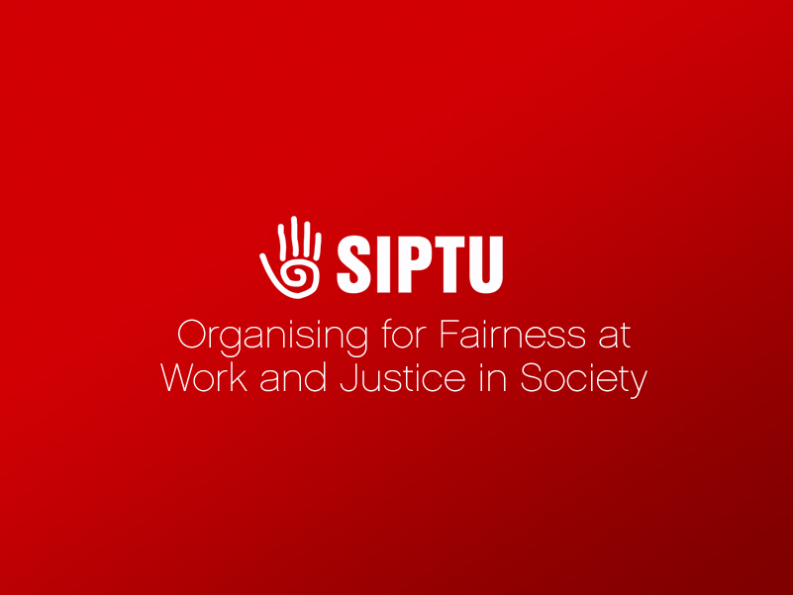
Thank You

