Slide 1




Slide 3

The past is an increasingly unreliable guide to the future
Technology
Globalisation
Employment
Climate Change
Politics
Demographics
Working life

Slide 4
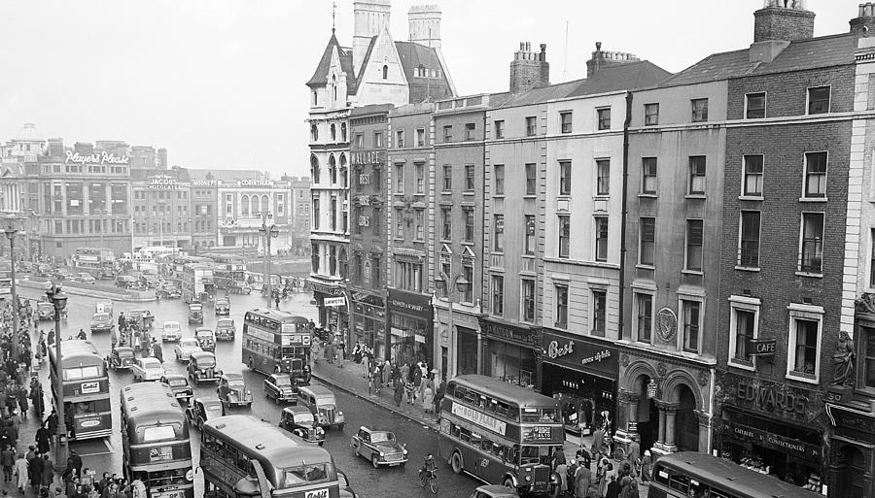
75%
Innovation

Slide 5
Survey of 6000 European workplaces: of firms which implemented self-managed teams, 68 per cent enjoyed reductions in costs, 87 per cent reported reduced throughput times, 98 per cent improved products and services, and 85 per cent increased sales.
In Sweden, firms using participative forms of work organisation were more productive (+20-60%), showed a much lower rate of personnel turnover (-21%), and a lower rate of absence due to illness (-24%) compared with traditionally organised enterprises.
Job design, teamworking, involvement in innovation and improvement, and employee voice all associated with improved well-being and health outcomes, especially when combined (Wood & Menenzes, 2011).
Job design, employee participation and management culture are amongst the most significant influences on health and well-being (Acas 2014; NICE, 2013)
Workplace changes in which employees play an active role lead to a convergence between high performance and high quality of working life, including enhanced health and well-being (Ramstad, 2009)
Enhancing Performance and Health

Slide 6


Beyond the fragments

Slide 7

DEFINING WORKPLACE INNOVATION

Slide 8
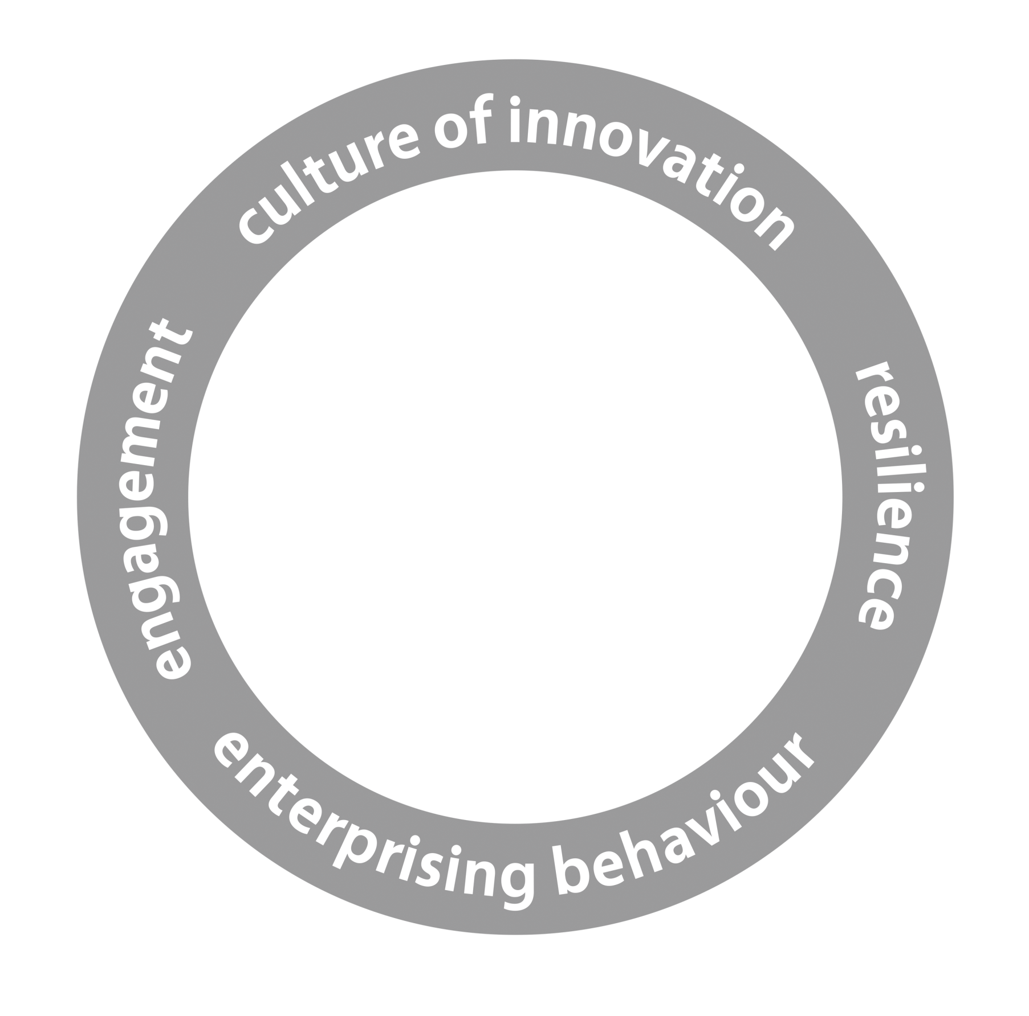
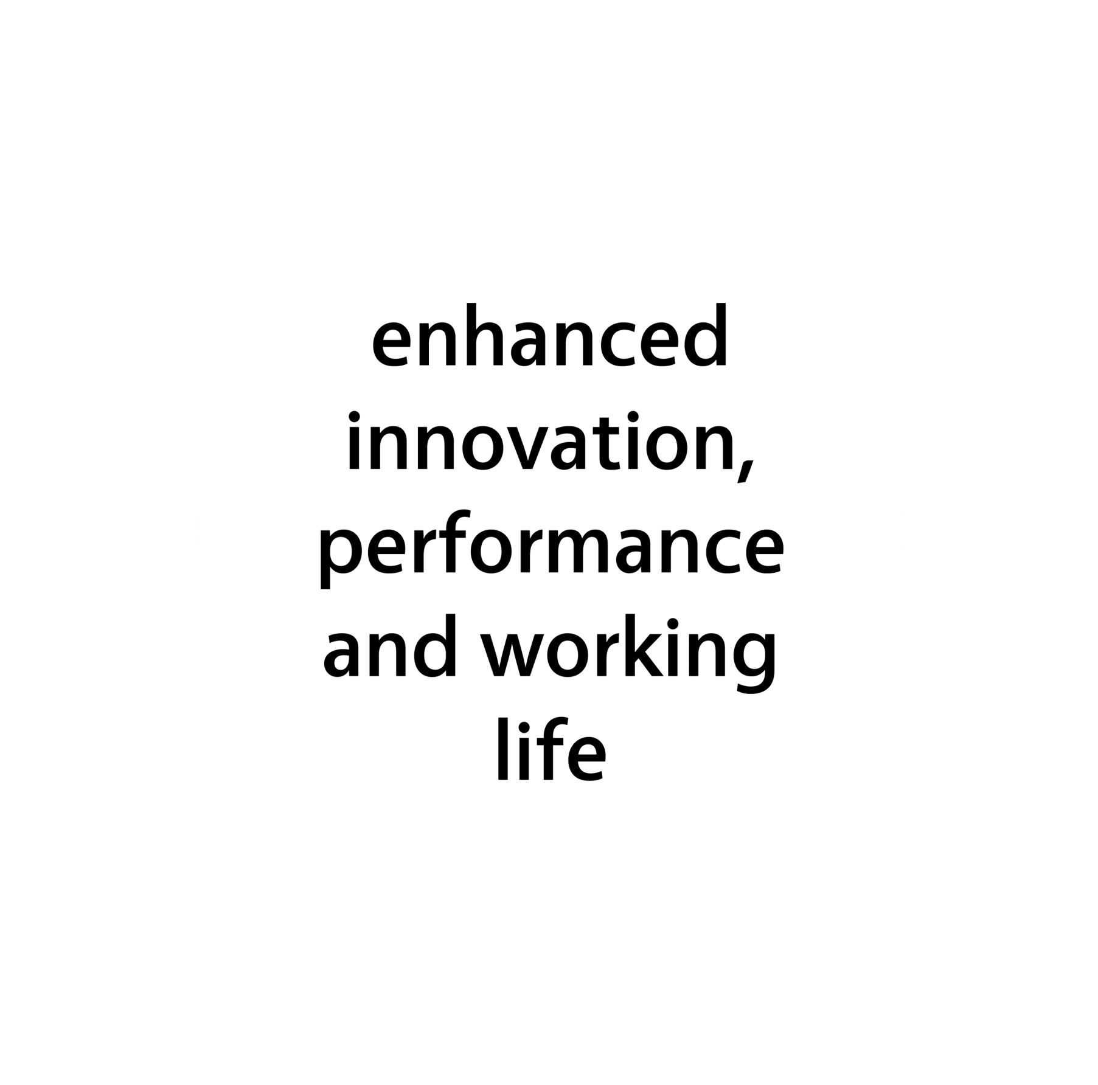


Slide 9
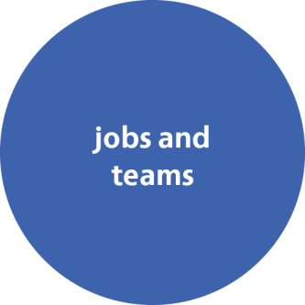
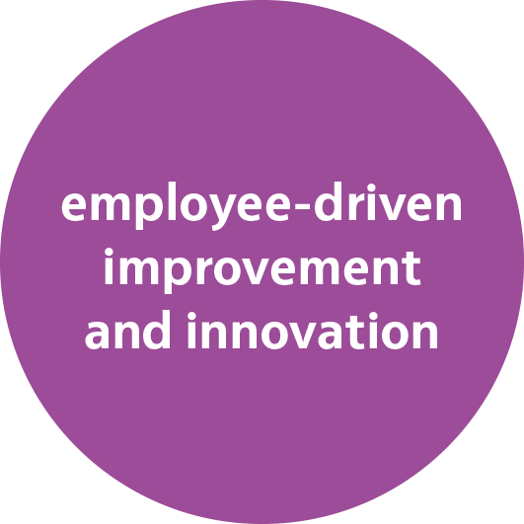







Slide 11
So if it works . . .
Organisations adopting workplace innovation practices systematically
. . . why isn’t everyone doing it?

Slide 12
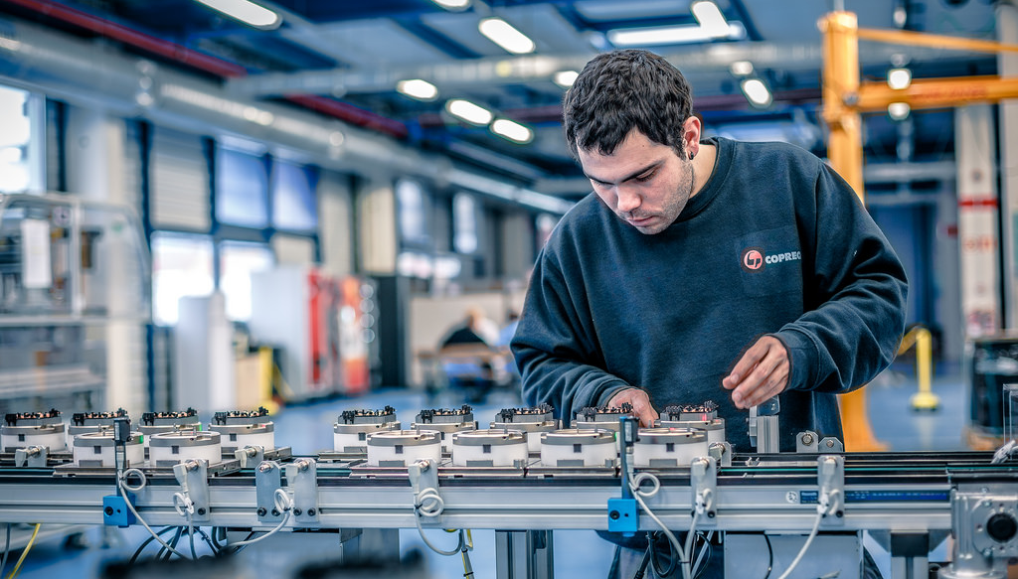
PERCENTAGE OF WORKERS IN DISCRETIONARY LEARNING JOBS
Austria | 32.3
Belgium | 31.9
Denmark | 43.3
Finland | 29.7
France | 20.2
Germany | 29.5
Greece | 13.7
Italy | 27.6
Ireland | 17.2
Luxembourg | 26.5
Netherlands | 44.1
Portugal | 27.9
Spain | 20.5
Sweden | 36.4
United Kingdom | 16.8

Slide 13

DISTANCE
DENIAL OF OPPORTUNITY
BIAS
DISENGAGEMENT
Keeping control

Slide 14

Obstacles to change
Lack of senior team commitment
Lack of knowledge
Not prioritised
Poor communication
Lack of employee participation
Line management
Partial change

Slide 15
Interdependencies

Slide 16
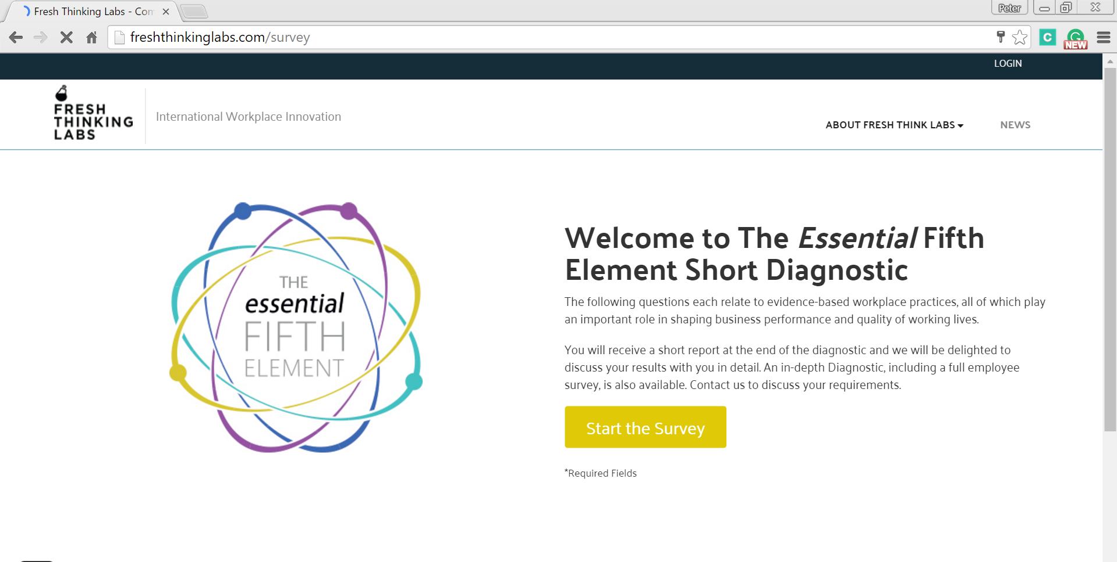
www.freshthinkinglabs.com/survey

Slide 17

The Essential Fifth Element Diagnostic
62 indicators of evidence-based workplace practices associated with performance and health
Companies can add their own organisational, occupational and/or demographic variables
Completion time 11 – 17 minutes
Results are grouped into 25 actionable themes to assist clarity and identification of interventions
Provides direct insights into opportunities for workplace innovation at organisational, departmental, team or demographic group levels

Slide 18
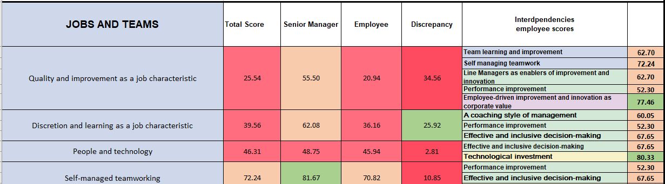
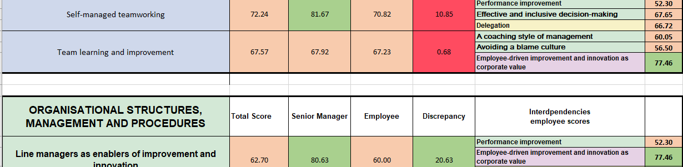
Diagnostic Report

Slide 19
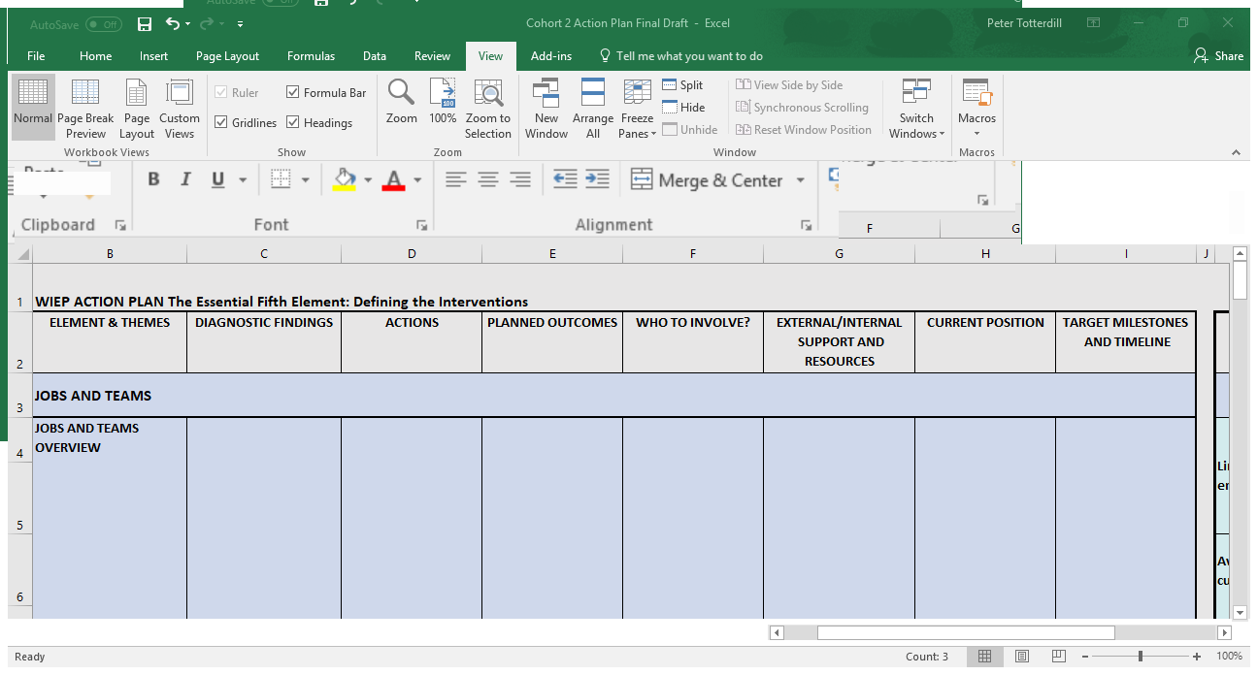
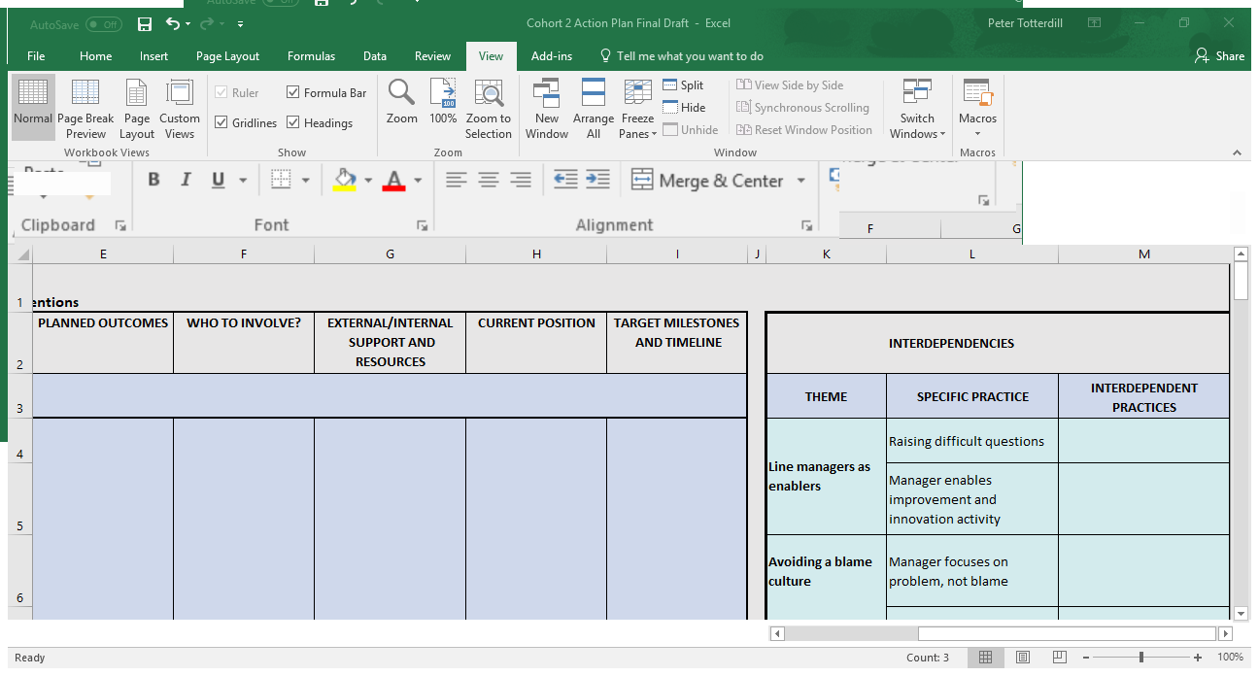
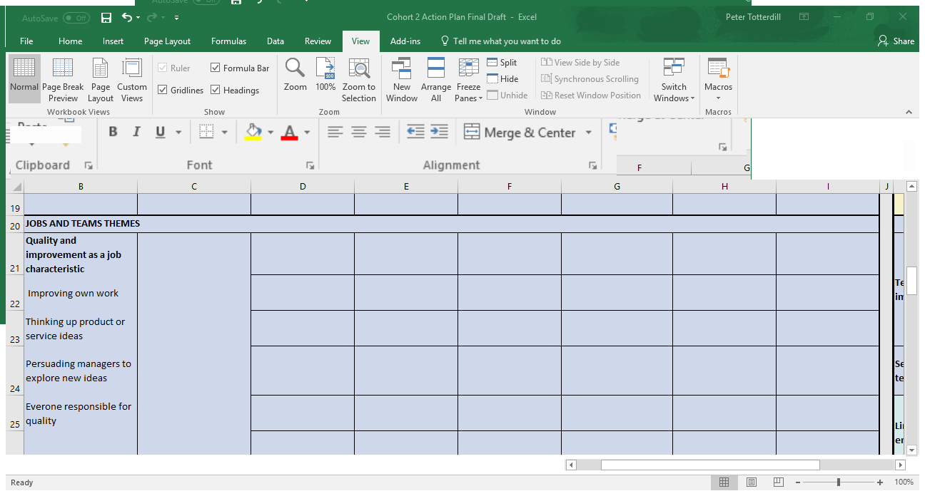
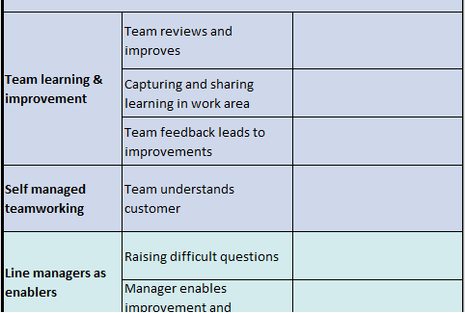
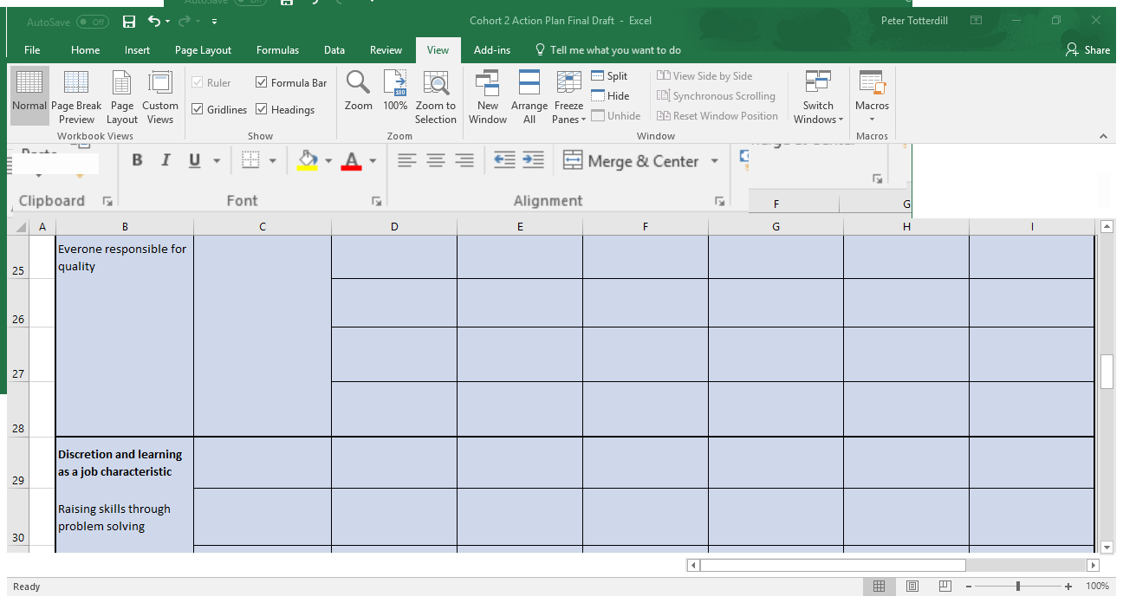
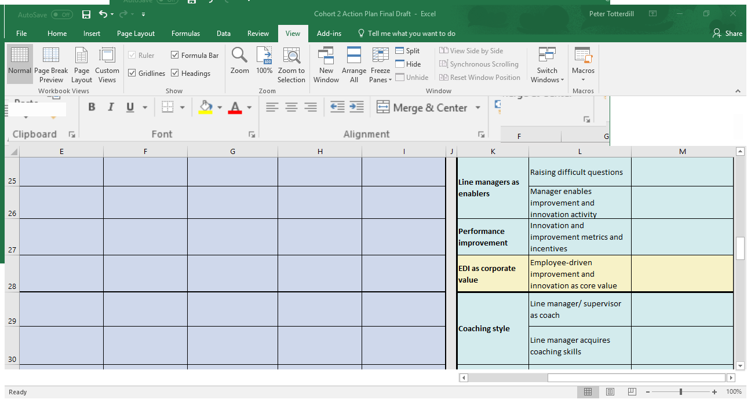
Action Plan Template
The template translates Diagnostic findings into action. It is based on the Four Elements subdivided into 25 groups of work practices, providing clear targets for intervention and change. ‘Interdependencies’ shows how the different groups influence each other.

Slide 20

Change
is messy

Slide 21
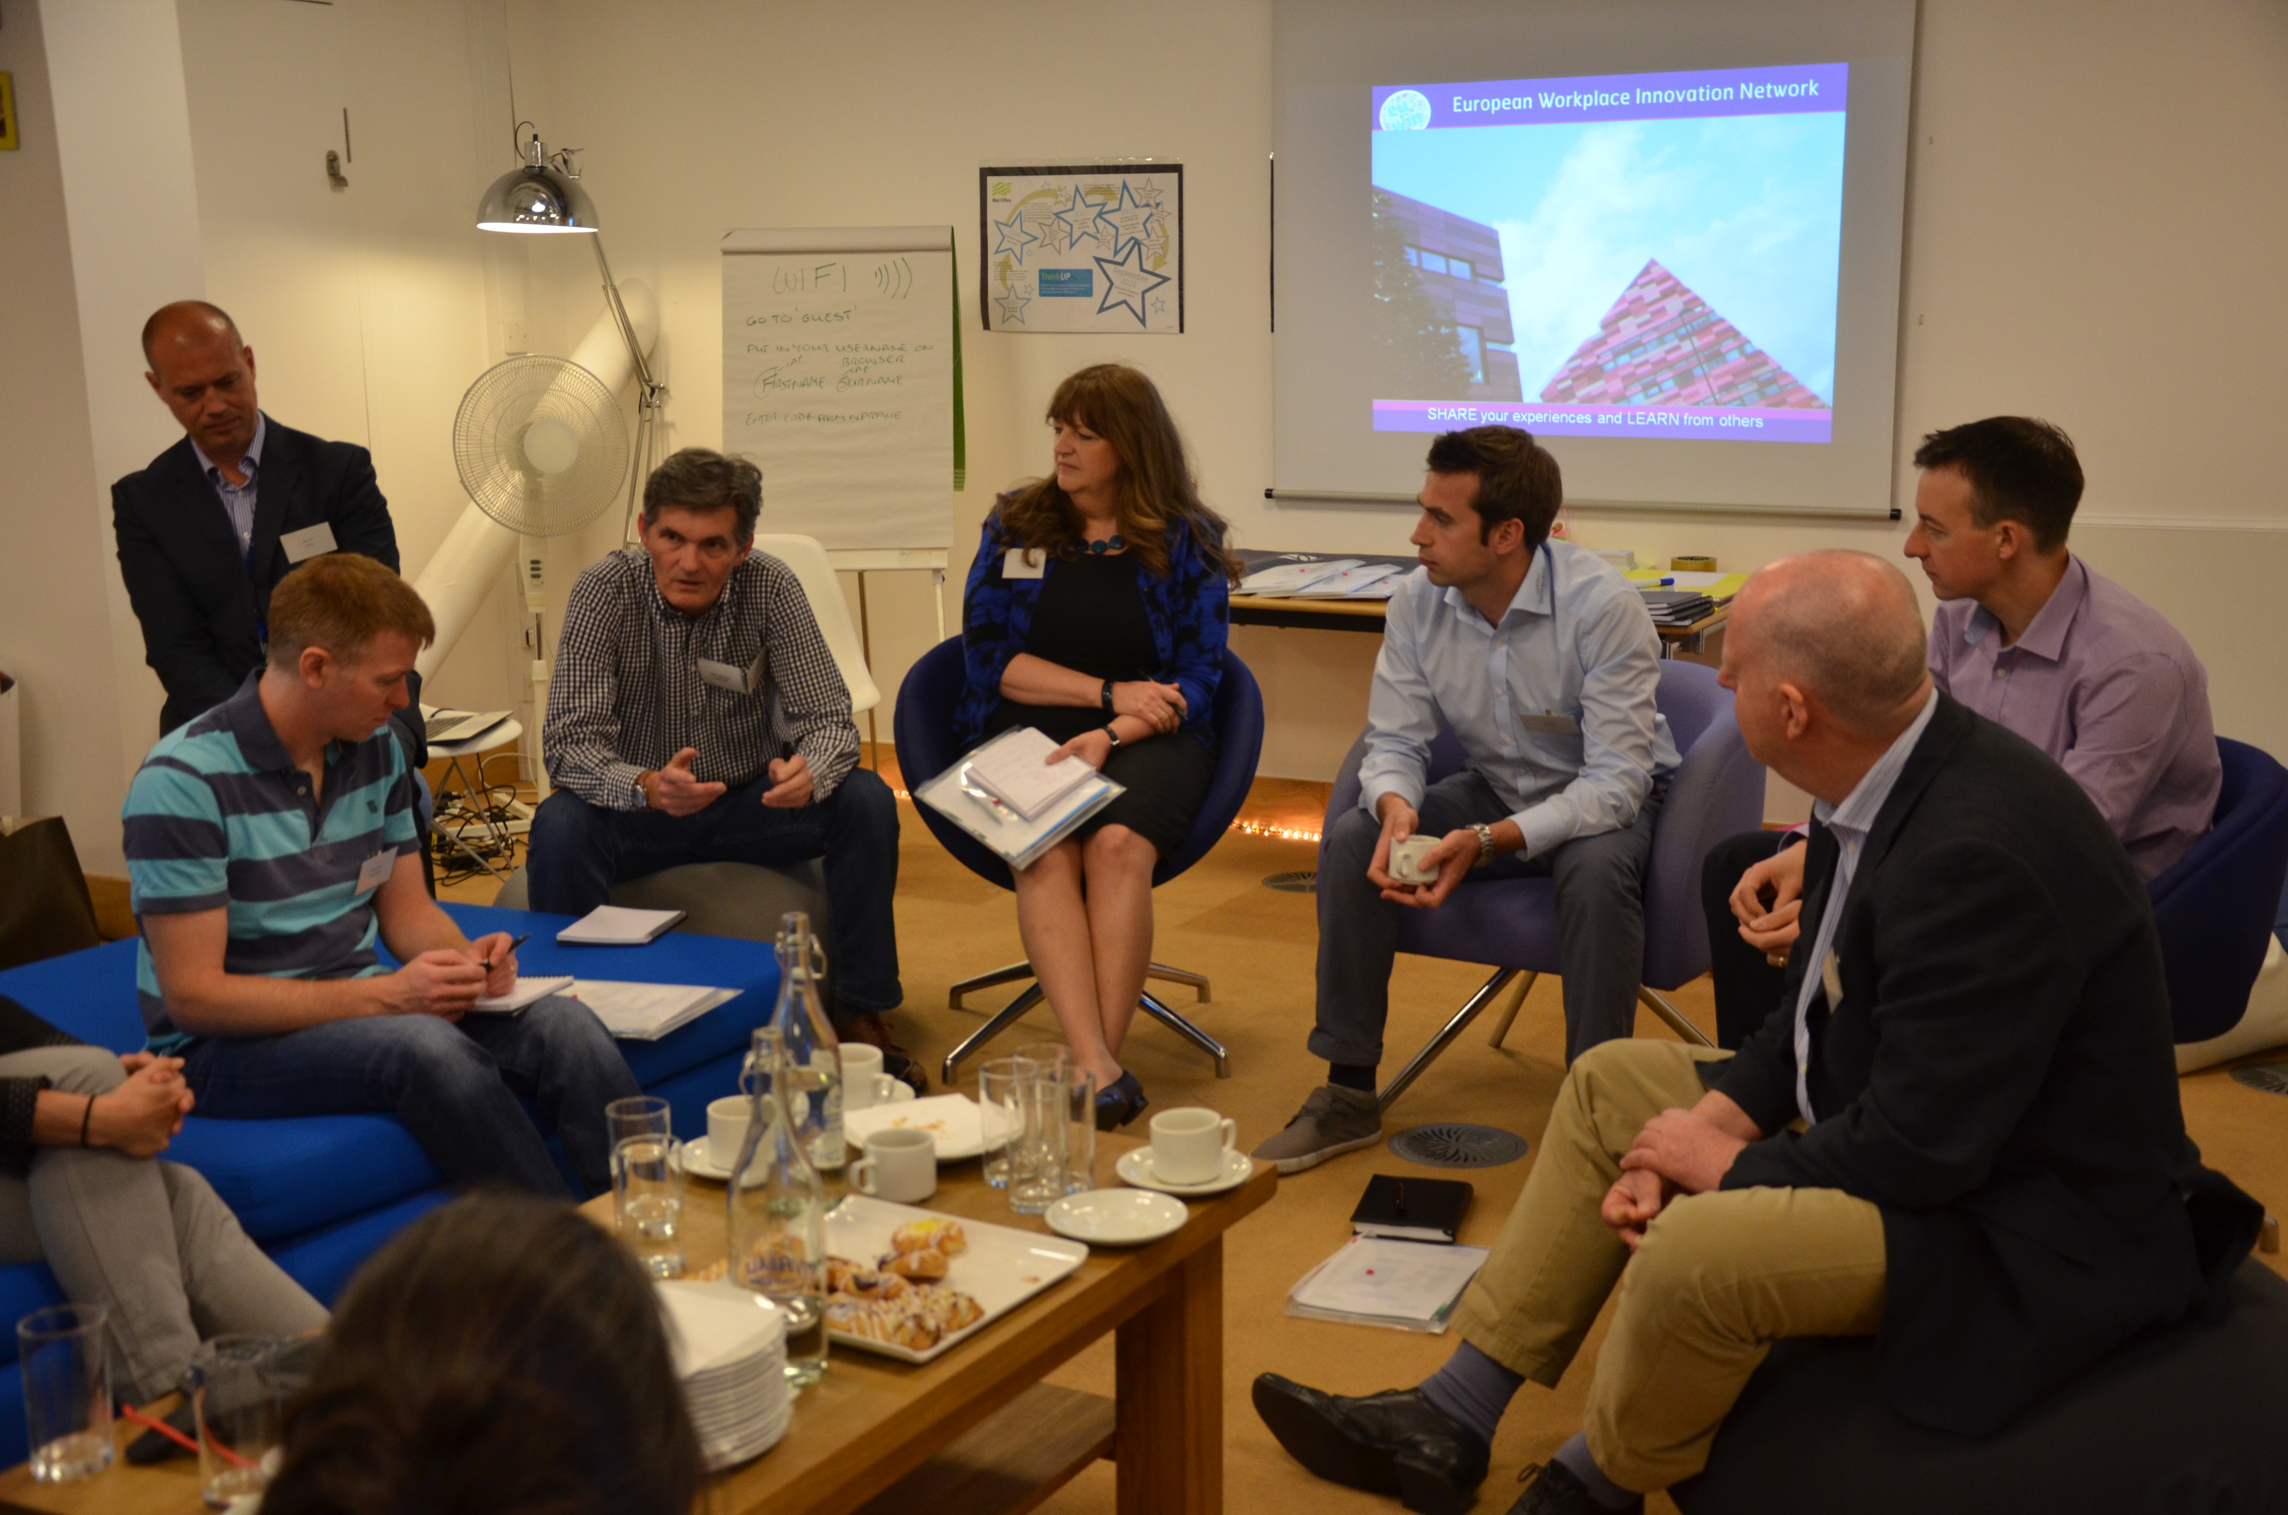
Absorptiveness

Slide 22


ONLINE AND IN PERSON
Your pathway to the best workplace practices
and latest thinking from across Europe and beyond
www.freshthinkinglabs.com

Slide 23
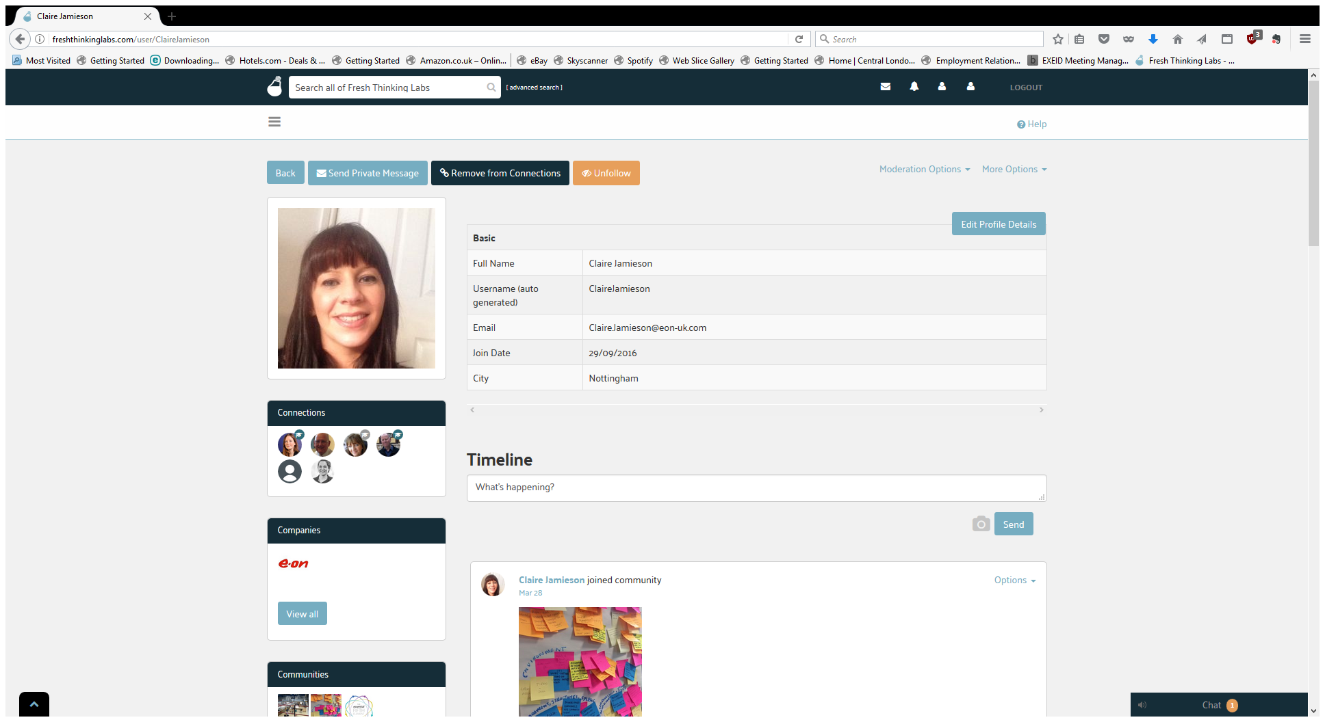

Slide 24
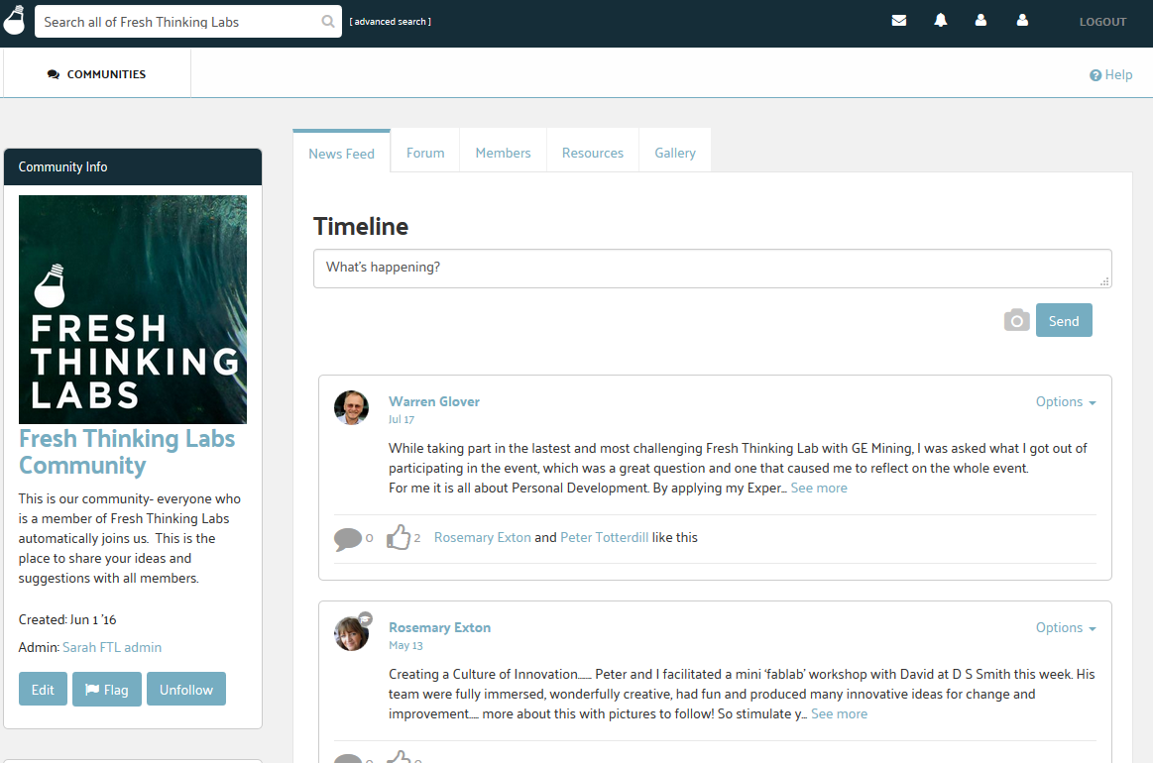

Slide 25
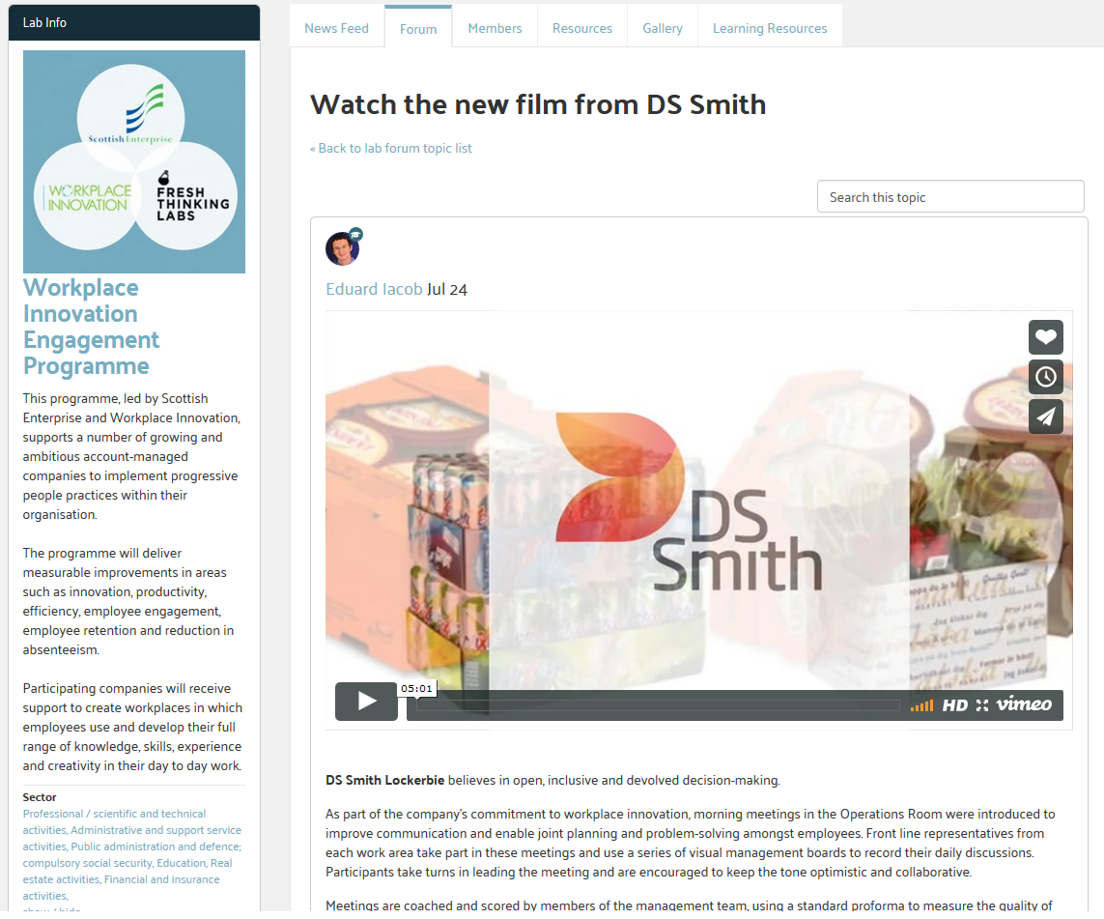

Slide 26
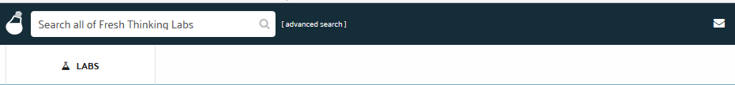
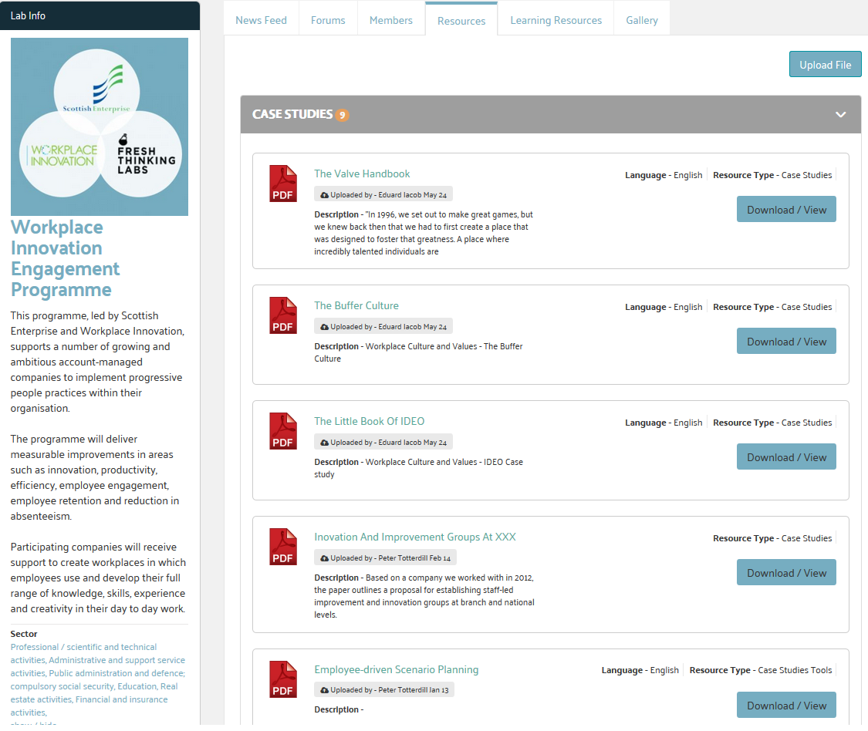
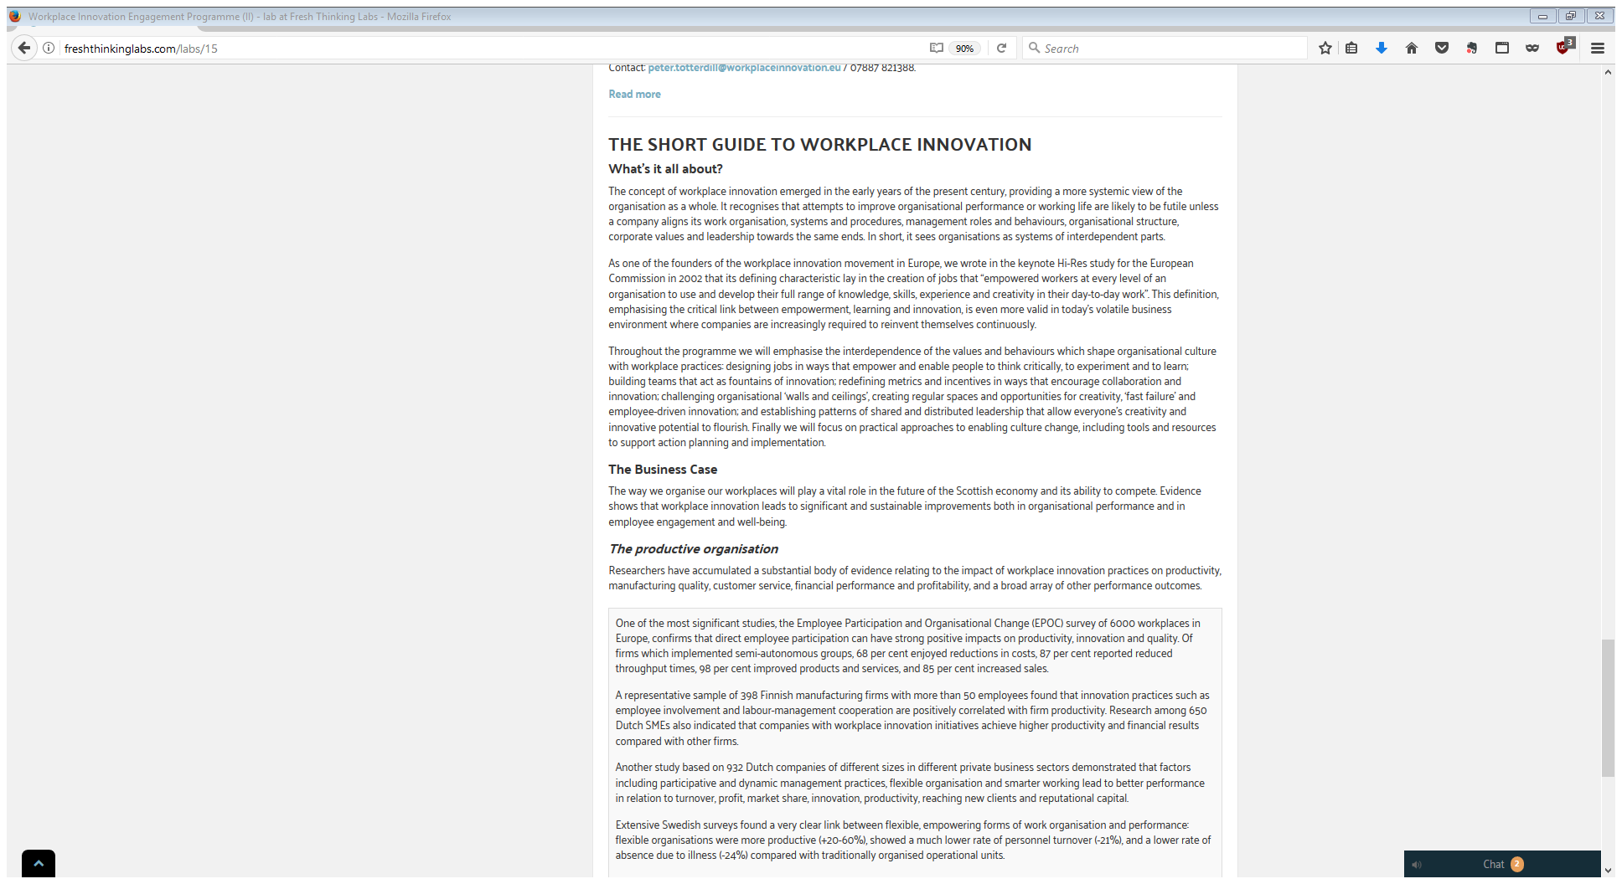
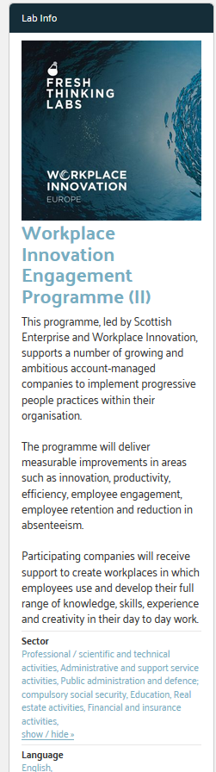

Slide 28
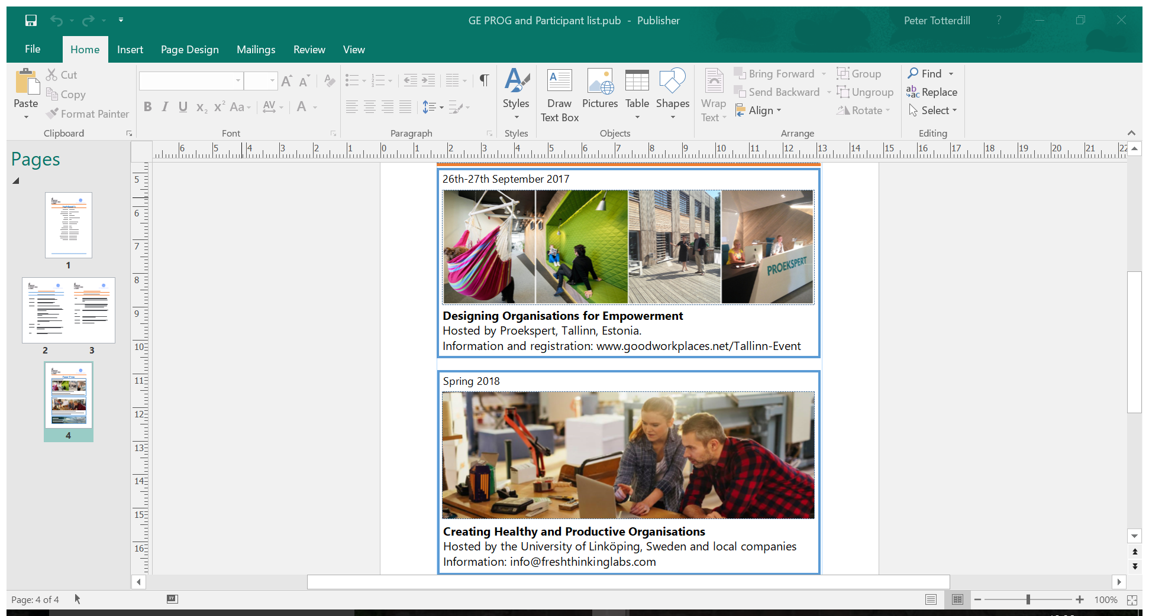
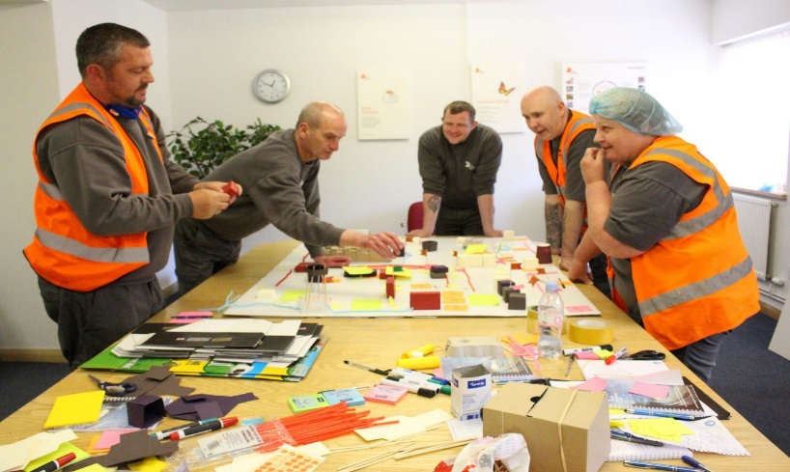





Slide 29
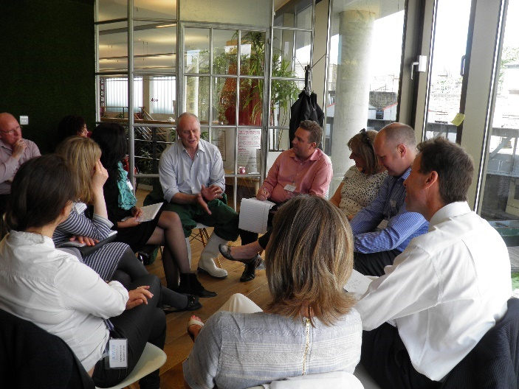


Leadership for Workplace Innovation

Slide 30
ONLINE AND IN PERSON
Your pathway to the best workplace practices
and latest thinking from across Europe and beyond
www.freshthinkinglabs.com

