Slide 1
Argenta Dundee
Workplace Innovation Engagement Program

Slide 2
Who are Argenta?
AlcheraBio CRO
Edison NJ
New Zealand based
Dedicated to animal health pharmaceuticals
Contract R&D
Contract manufacturing
Dundee CMO
Scotland
AML Riverside CMO
Fort Dodge IA
Argenta CRO
Lawrence KS
Argenta CMO & CRO
Auckland NZ

Slide 3
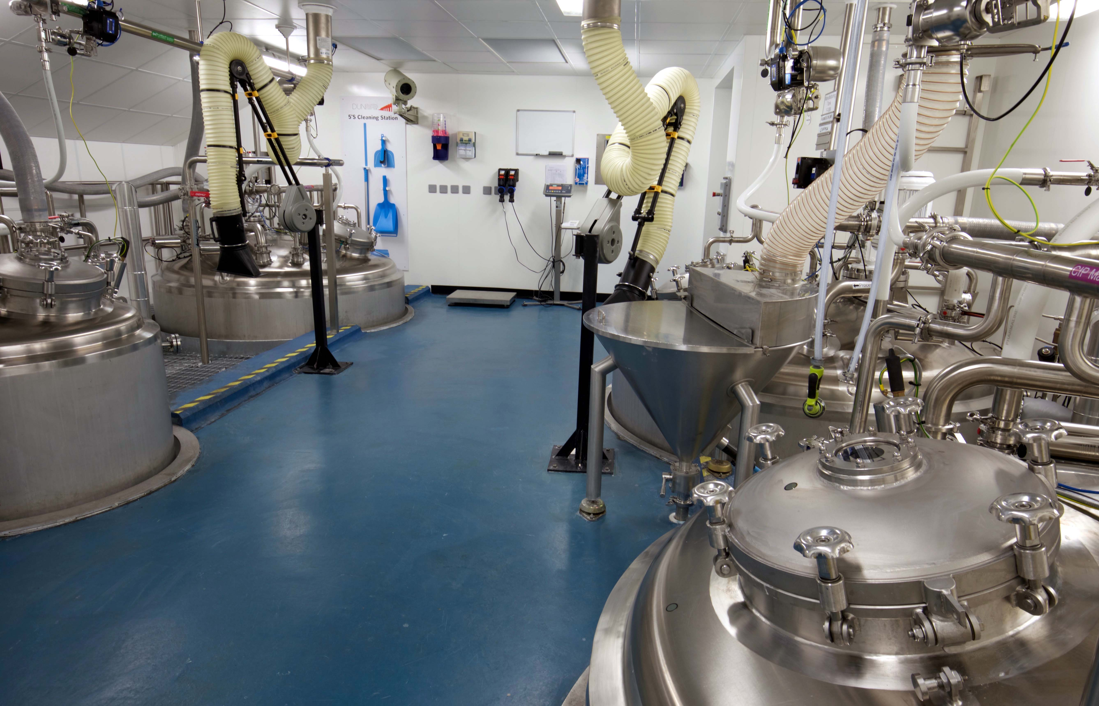
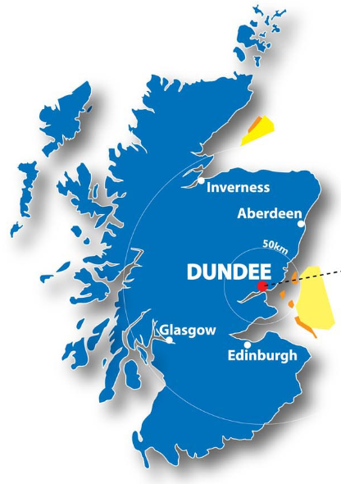
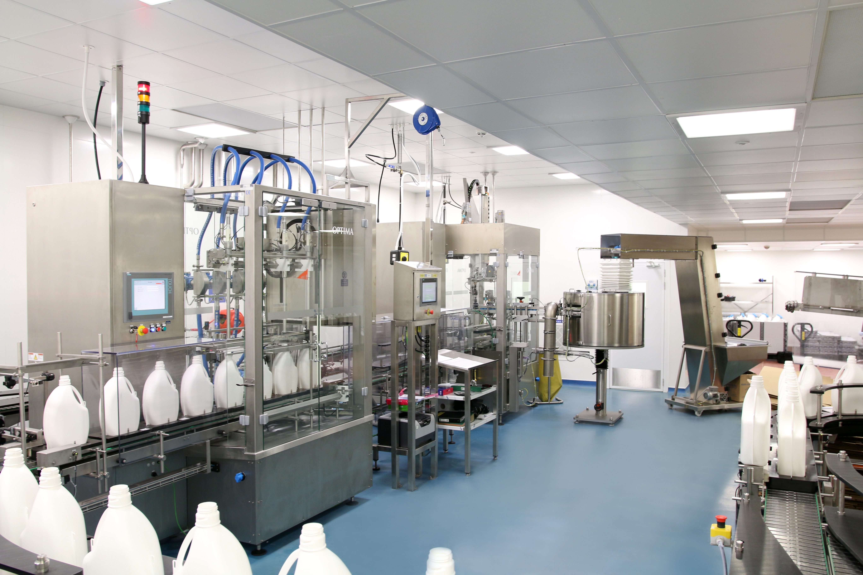
Dundee Manufacturing Site
Argenta’s latest acquisition, Apr 17
Formerly part of Novartis and Eli Lilly
140 employees
Non-sterile liquids
Gels and semi-solids
Micro-dose tube filling
Endo-parasiticides and ecto-parasiticides

Slide 4
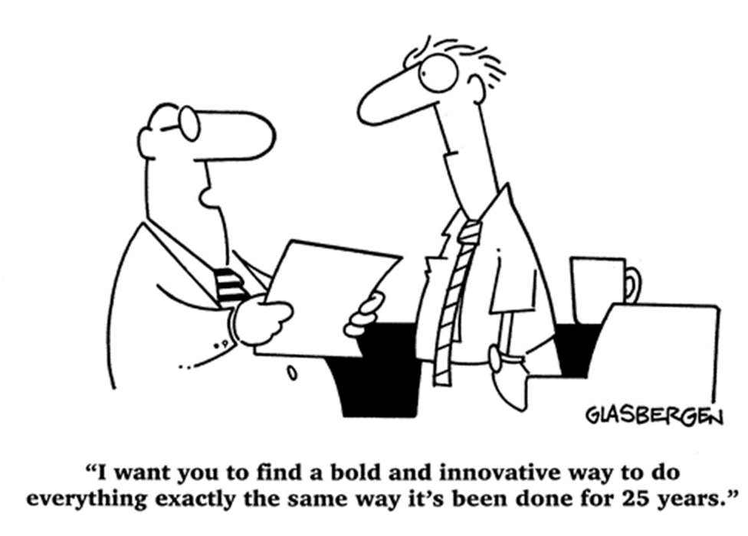
The paradox of workplace innovation & operational excellence in a regulated environment
“The only sustainable competitive advantage is an organization's ability to learn faster than the competition.” ― Peter Senge

Slide 5
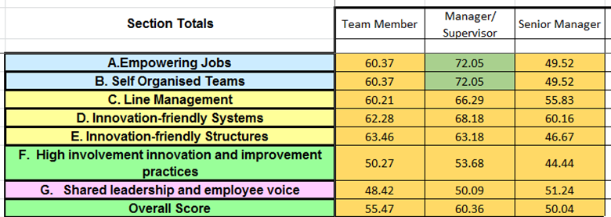
Workplace Innovation - WIEP
Action plan from initial results focused on:
Breaking down interdepartmental silos
Improving the flow of information
Empowering decision making at lowest practical level

Slide 6
Practical Initiatives
Separate goals and modes of operation in different departments are a potential cause of frustration.
Product Support Hub
Co-locate key departments/individuals together to promote:
Breaking down of departmental silos
Organizational structures that reflect workflow rather than functional divisions
Self-management of daily issues.

Slide 7
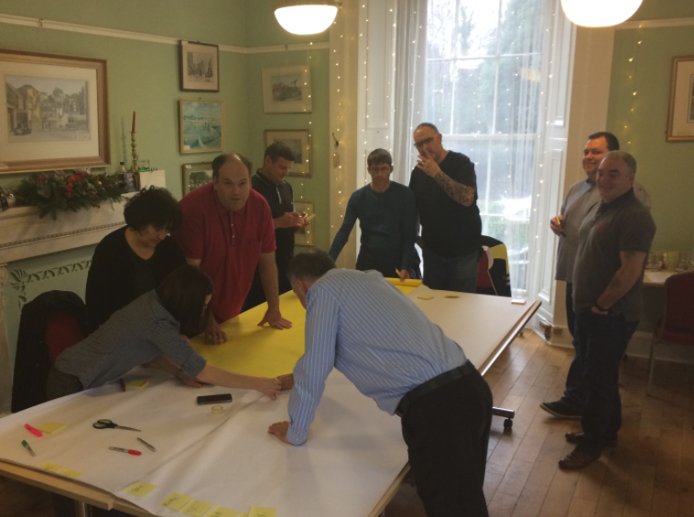
Production Leadership Transformation
Survey Results:
Roles may be too narrow
Decision making not delegated to the lowest possible level.
Limited opportunities to develop or use skills and experience for improvement/innovation.
Or those opportunities are not being identified as such.
Role | Time Saved
Senior Op L&P | 4.0
Senior Op Man | 3.5
Shift Lead | 3.5
Production Lead | 1.5
Total | 12.5

Slide 8
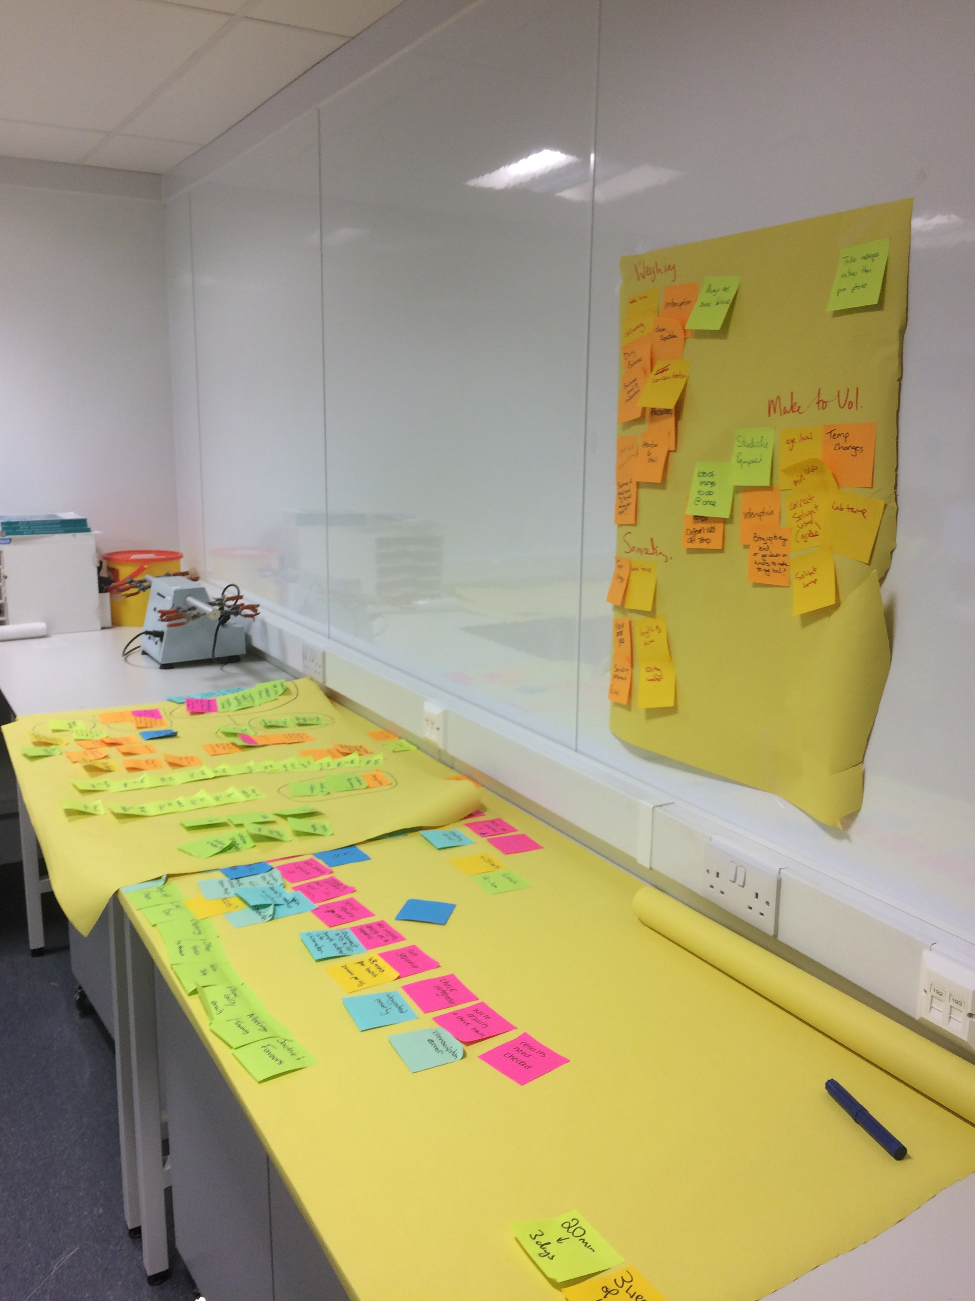
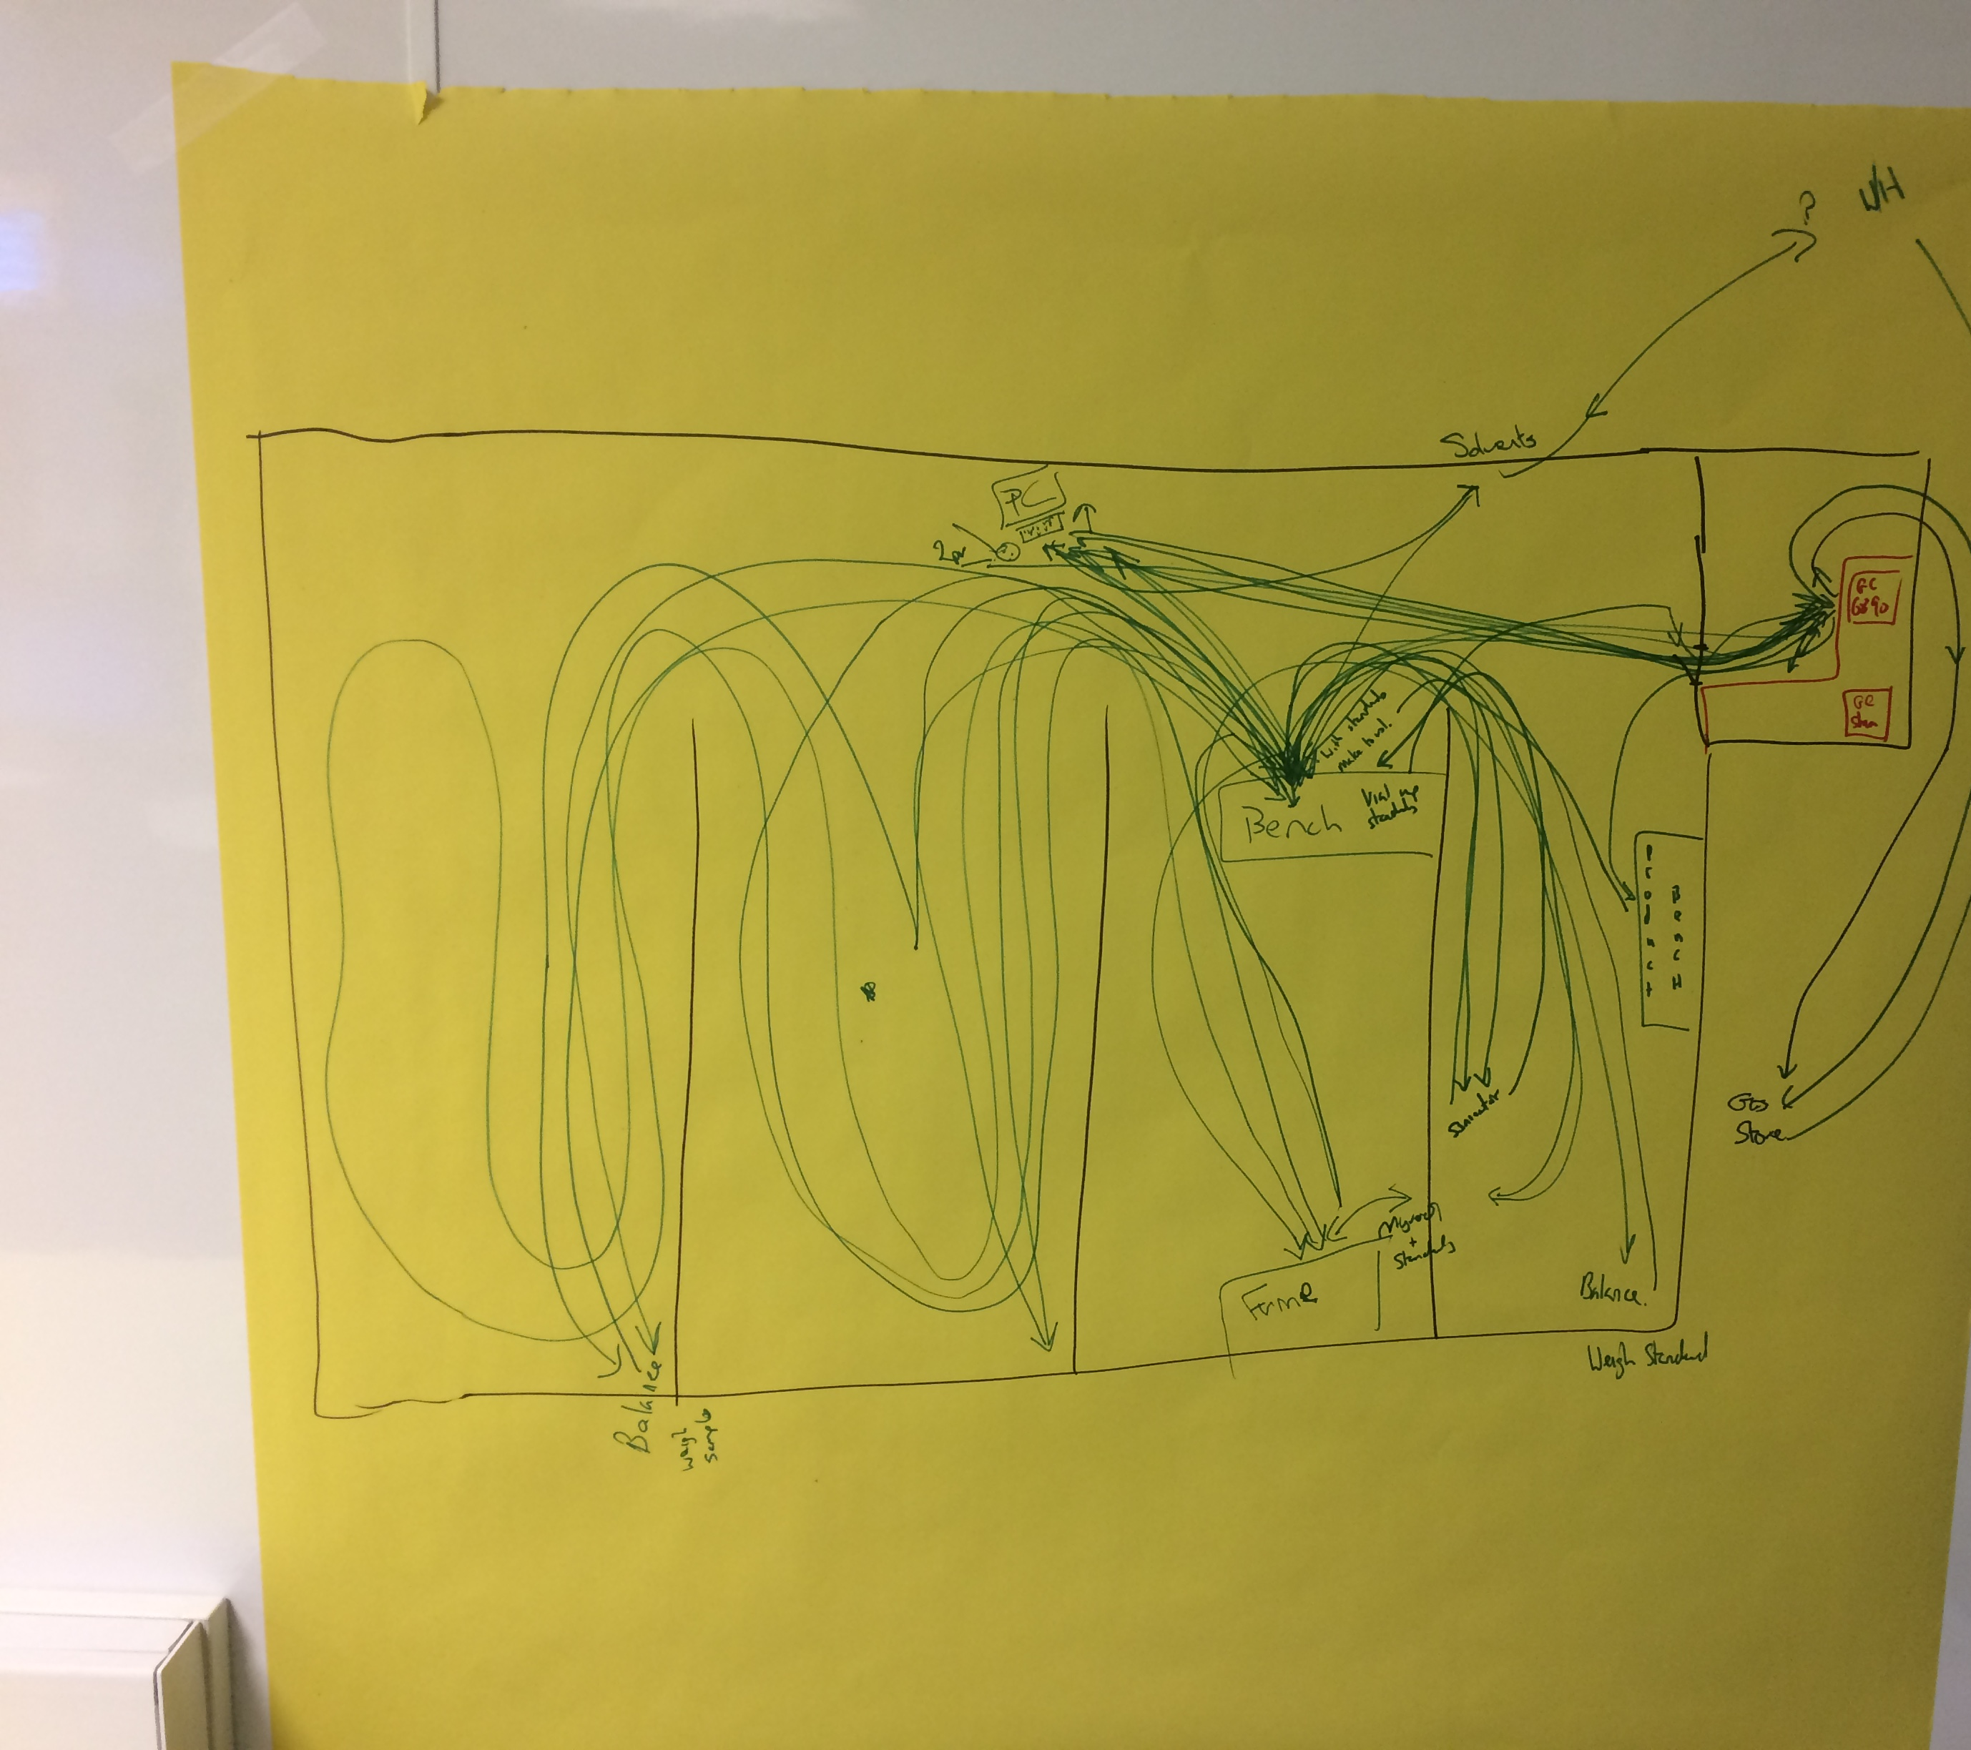
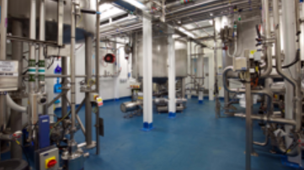
Highlights!
Physiological safety of projects
Conversations
Process mapping
Confidence
We’ve saved some money, had lots of fun!
The foundations are being laid for growth

